Slide 1
Section 4
Runs Test of Randomness
- Presented by Weihong Li

Slide 2

Runs Test
Purpose
  Determine whether the number of runs of ones and zeros of various lengths is as expected for a random sequence.
  Or determine whether the oscillation between zeros and ones is too fast or too slow.
Prerequisite
  Frequency test -
Two tests
  1. Test for the number of Runs in a sequence.
  2. Test for the longest Run of ones in a block.
Notes:
An oscillation is considered to be a change from a one to a zero or vice versa.
Before doing Runs test, we need to do the frequency test first. Namely, to check whether the number of 1’s is equal to the half of the total number or not. Pi is the proportion of ones in the input sequence. T is a threshold, and preset to 2/sqrt(n)
If the input sequence can not pass the frequency test, then, we do not need to do the runs test any more.
There are two tests associated with the runs test:…, before we dig into these tests, let’s first take a look at definitions of the runs and the length of runs.

Slide 3
Definitions for Runs
Runs
  - An uninterrupted sequence of identical bits.
The length of Runs
  Classical definition of a success run of length r (no recurrent pattern)
    - An uninterrupted sequence of either exactly r, or of at least r, sucesses.
        000010000001 : 2 0-runs of length 3, ending at 3, 8
  Feller definition (recurrent pattern)
    - A sequence of n letters S and F contains as many S-runs of length r as there are non-overlapping uninterrupted successions of exactly r letters S.
        000010000001 : 3 0-runs of length 3, ending at 3, 8, 11.
  Overlapping definition (recurrent pattern)
    000010000001 : 6 0-runs of length 3, ending at 3, 4, 8, 9, 10, 11.
Notes:
Feller gave a definition of Runs based on recurrent pattern.

Slide 4
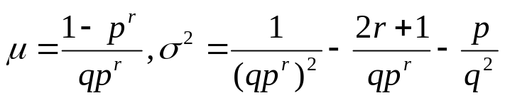
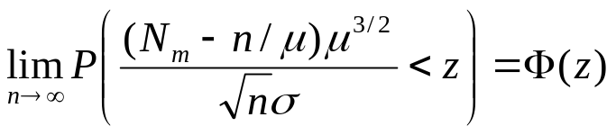



Run Test Based on Feller Definition
The mean and variance of the recurrence times of runs of length r are (Feller, 1968, XIII.7):
  Let r = m, p = q = ½, we have
For fix length m, the number of Feller defined runs is approximately normal:
  It can be seen that,
  with , the P-value is:
Notes:
The advantage of the feller definition is: the moments of the occurrences of a run of length m admit a fairly simple generating function with explicit formulas for the mean and variance.

Slide 5

Runs Test Based on Classical Definition
Runs test in the test suit, which is based on classical definition, tests the distribution of the total number of runs, V_{n} . For a fixed proportion π of ones in the sequence of size n, the limiting distribution of the total number of runs is known to be normal:
    - The P-value is:
Large values of V_{n}(obs) indicate oscillation in the sequence is too fast, small values indicate oscillation is too slow.
Notes:
The use the classical definition of Runs.
where a run is an uninterrupted sequence of identical bits. A run of length k consists of exactly k identical bits and is bounded before and after with a bit of the opposite value.

Slide 6
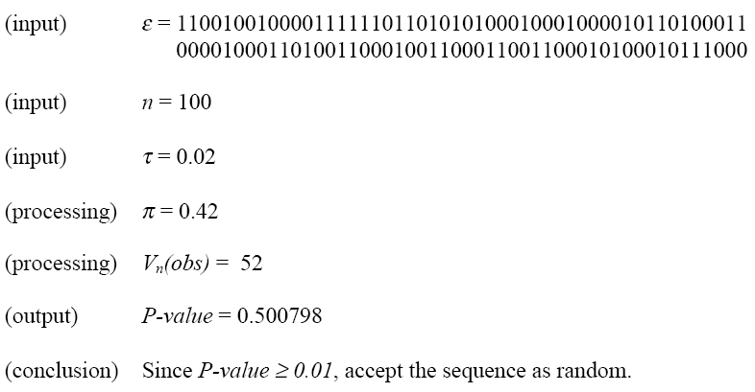
Example of Runs Test*
* A. Rukhin, et al “A Statistical Test Suite For Random And Pseudorandom Number Generators For Cryptographic Applications”
Notes:
This is Runs test example

Slide 7
Test for the Longest Run
Purpose
  determine whether the length of the longest run of ones within the tested sequence is consistent with the length of the longest run of ones that would be expected in a random sequence.
A test for ones is enough (no need for zeros)
  An irregularity in the expected length of the longest run of ones implies that there is also an irregularity in the expected length of the longest run of zeroes. So only a test for ones is necessary.
Notes:
The focus of the test is the longest run of ones within M-bit blocks. The purpose of this test is to
determine whether the length of the longest run of ones within the tested sequence is consistent
with the length of the longest run of ones that would be expected in a random sequence. Note
that an irregularity in the expected length of the longest run of ones implies that there is also an
irregularity in the expected length of the longest run of zeroes. Therefore, only a test for ones is
necessary. (Similar to the proportions: if we know the proportion of ones in the sequence, then, we know the proportion of zeros in the sequence)

Slide 8



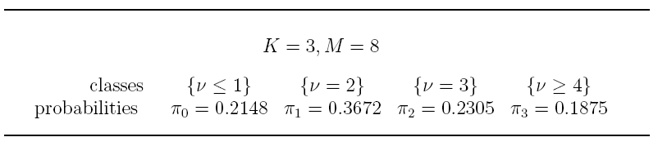
Test for the Longest Run of Ones in a Block
As in the section 2, we partition a sequence of length n into N blocks of size M, namely, n=MN. If in the block we have m ones, the conditional probability that the longest string of ones ν in this block is less than or equal to k has the following form:
where
so that
The theoretical probabilities π₀ π₁,…, π_{K} are determined from the above formula.
For example
Notes:
The focus of the test is the longest run of ones within M-bit blocks. The purpose of this test is to
determine whether the length of the longest run of ones within the tested sequence is consistent
with the length of the longest run of ones that would be expected in a random sequence. Note
that an irregularity in the expected length of the longest run of ones implies that there is also an
irregularity in the expected length of the longest run of zeroes. Therefore, only a test for ones is
necessary.

Slide 9



Test for the Longest Run of Ones in a Block
For each of these substrings, the frequencies, v₀ v₁,…, v_{K} , of values of the corresponding statistic within each of K+1 chosen classes, v₀+v₁+…+v_{K} = N are evaluated. And the empirical frequencies v₀ v₁,…, v_{K} are conjoined by the χ²-statistic as stated in the Section 2.
  Which, under the randomness hypothesis has the approximate χ²-distribution with K degrees of freedom. The reported P-value is
  With P(a,x) denoting the incomplete gamma function
Notes:
The focus of the test is the longest run of ones within M-bit blocks. The purpose of this test is to
determine whether the length of the longest run of ones within the tested sequence is consistent
with the length of the longest run of ones that would be expected in a random sequence. Note
that an irregularity in the expected length of the longest run of ones implies that there is also an
irregularity in the expected length of the longest run of zeroes. Therefore, only a test for ones is
necessary.

Slide 10
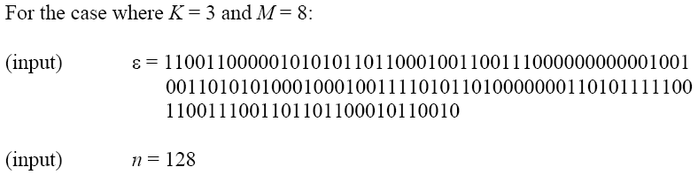
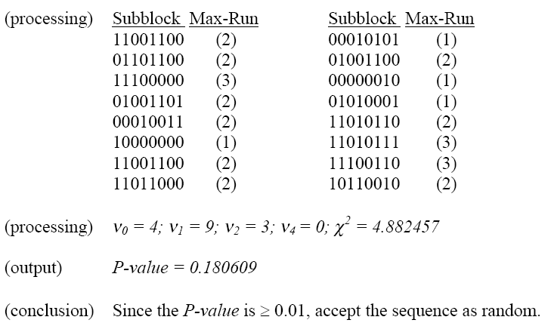
Example of Longest Run
Notes:
This is Runs test example

Slide 11
The End
Thank You!

Slide 12

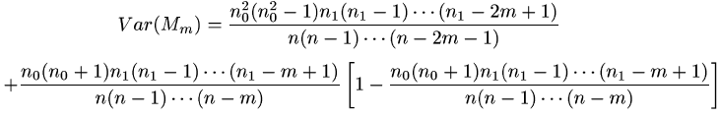
Moments for Classical Defined Runs with fixed length
M_{m} denotes the total number of runs of length m in a string of size n with n₁ ones and n₀= n - n₁ zeros, then
Notes:
The use the classical definition of Runs.
where a run is an uninterrupted sequence of identical bits. A run of length k consists of exactly k identical bits and is bounded before and after with a bit of the opposite value.

Slide 13



Non-fixed Length Runs
If m is allowed to grow as n increases, and
Then, W(m,n), the number of Feller defined, non-overlapping runs of length m, has a Poisson limit
However, , the number of overlapping runs of length m in the string has a compound Poisson distribution, with the moment generating function

Slide 14
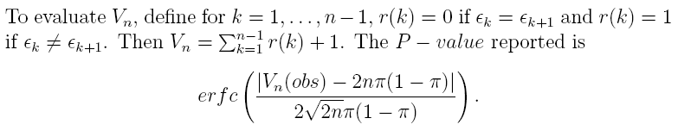


Appendix

Slide 15
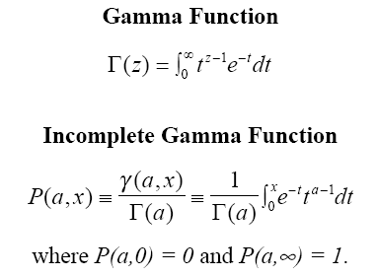
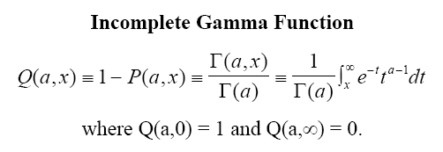
Appendix

